Slide 1


Procedural Planet

Slide 2
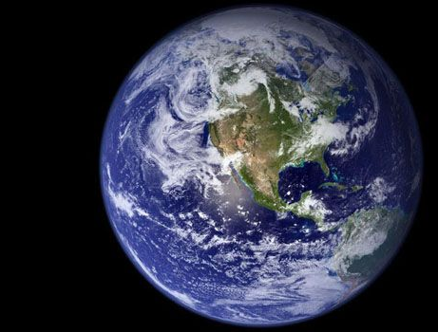
Problem
Render realistic-looking planets with atmosphere and clouds.

Slide 3
Approach
Sphere
Terrain
Colouring
Ocean
Atmosphere
Clouds
Others

Slide 4
Implementation Details
C++
GLFW for windows
GLAD for OpenGL loading
GLM for vector math
DearImGui for UI
Input data
Almost everything is procedurally generated
Normal map

Slide 5

Sphere

Slide 6
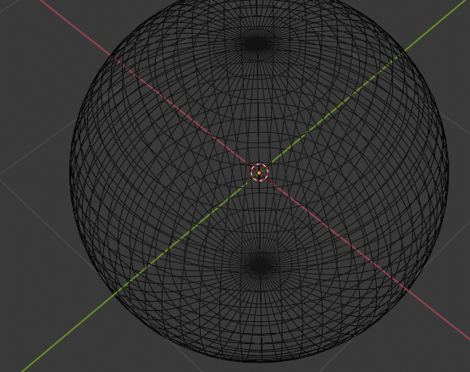
UV Sphere
Simple enough to implement
Not very suitable, because most of the vertices are localised near the poles

Slide 7
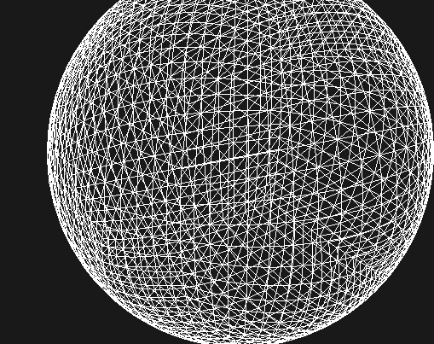
Cubesphere
Get a cube, subdivide its faces, then project vertices to a sphere
Relatively fine-grained control, and more distributed vertices

Slide 8

Terrain

Slide 9
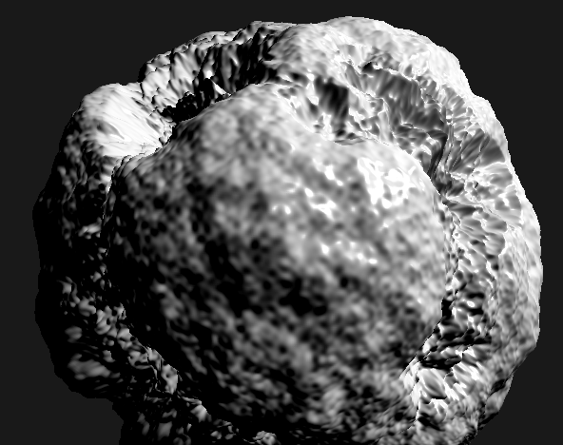
Noise
3D Noise
Code obtained online
Octaves
How many layers of noise
Persistence
How much each layer contributes
Lacunarity
How zoomed in each layer is
Ocean
Lower vertices below a certain height + additional smoothing

Slide 10

Colour

Slide 11
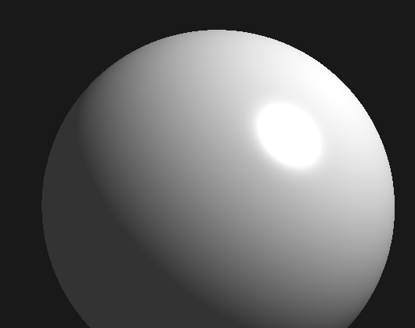
Lighting
Phong lighting
Simple to implement
Focus won’t be on the planet, so no need for a more complex lighting model
Normal calculation
Take close samples (with noise) and calculate cross product

Slide 12
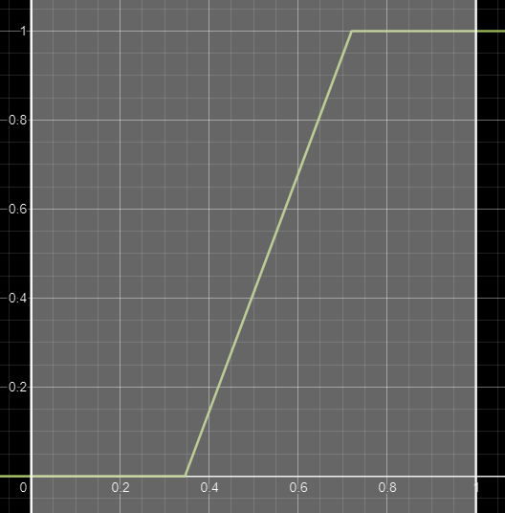
Blending
Blend factor and threshold
C = threshold * (1 – blend)
K = (X – C) / (threshold – C)
Saturate
Clamps value between 0 and 1
GLSL mix(a, b, k)
V = a * (1 – k) + b * k

Slide 13
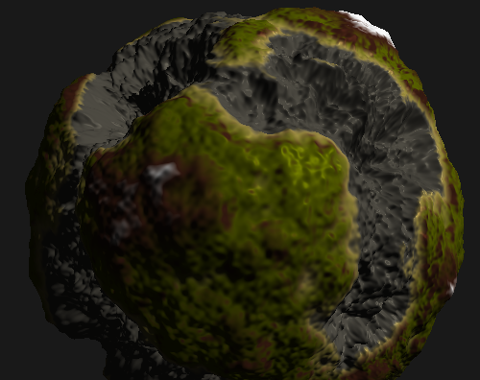
Colours
5 types of colours
Shore (Sand)
Grass
Rock
Snow
Seafloor
Each has their own associated blending parameters

Slide 14
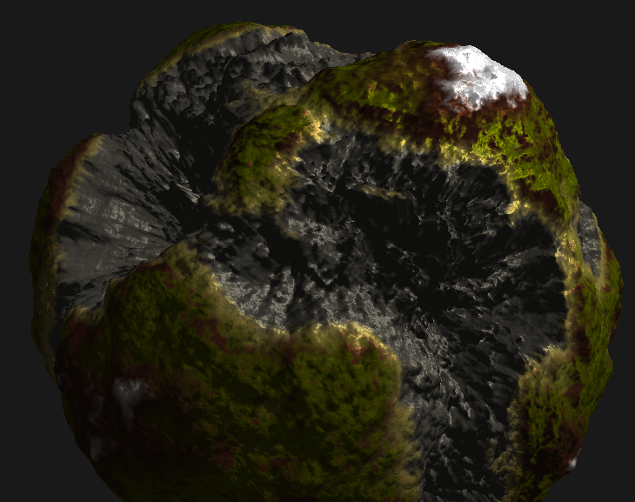
Detail
Normal map to add detail to terrain
Triplanar normal mapping to calculate new normals for diffuse and specular lighting

Slide 15

Ocean

Slide 16
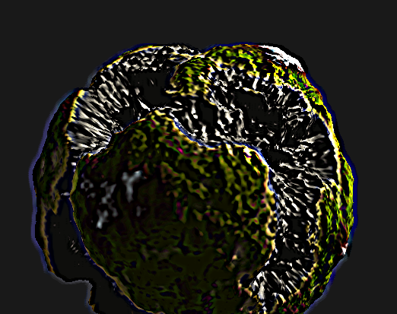
Framebuffers
Instead of rendering directly to the screen, render to an intermediate buffer first
Allows for post-processing effects

Slide 17
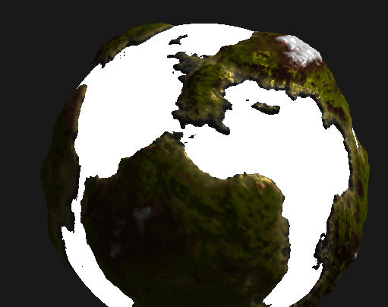
Ocean
Ray-sphere intersection to get distance between sphere and camera
Sample depth texture to calculate distance between vertex and camera
If vertex distance is larger than sphere distance, draw the ocean
Keep the original colour otherwise

Slide 18
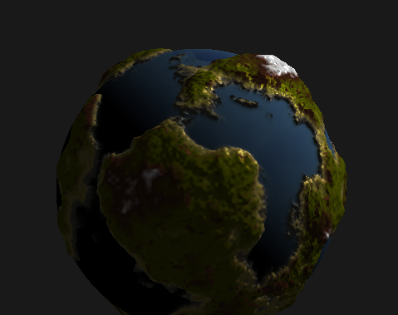
Ocean Colour
Blend between deep and shallow regions (based on depth texture)
Ocean transparency (See the ocean floor)

Slide 19
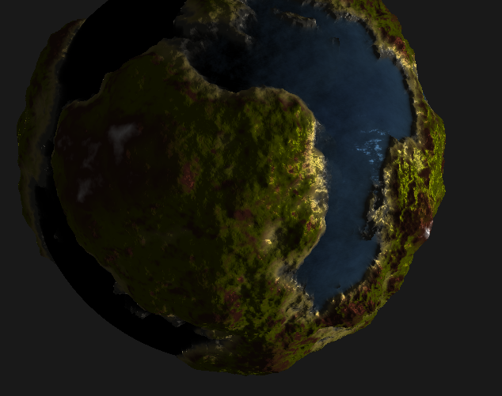
Waves
Can’t have physical waves because the ocean is a post-processing effect
Use a water normal map, and offset it (as a function of time) to simulate “waves”
Triplanar normal mapping again for diffuse and specular lighting

Slide 20

Atmosphere

Slide 21
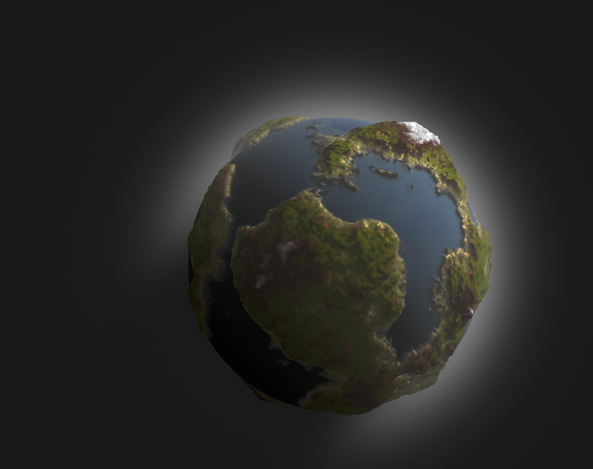
Atmosphere
Another ray-sphere intersection to determine the distance through the atmosphere
Sample points along the view ray through the atmosphere, then calculate how much light is scattered in from the Sun

Slide 22
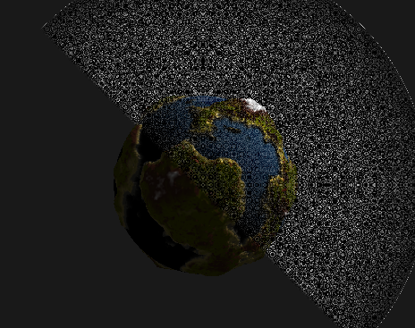
Precision
Noisy patterns caused by precision issues
Add a small value (1e-3) when calculating the ray-sphere intersection

Slide 23
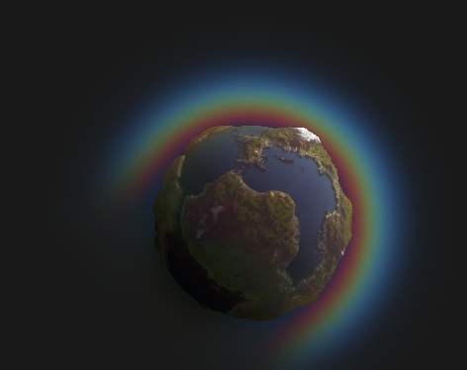
Colour
Different wavelengths of light scatter with different strengths
Get physical wavelengths of RGB light (700 nm, 530 nm, 440 nm), and modify the scattering functions to scatter different colours accordingly

Slide 24

Clouds

Slide 25
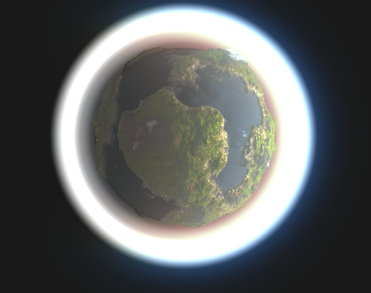
Cloud Layer
Define the cloud layer as a spherical shell with a top and bottom radius
Ray-sphere intersection with the larger sphere
Ray-march the clouds similar to the atmosphere
Height signal to determine if a given point is within the shell

Slide 26
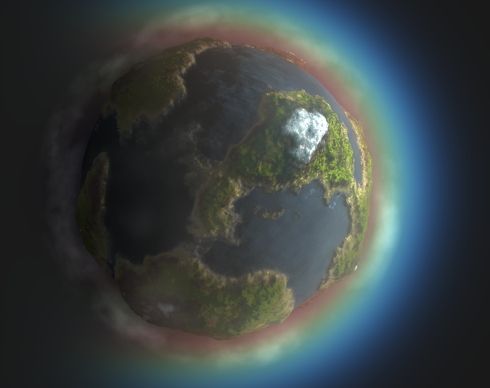
Cloud Shape
Layered 3D Perlin noise (same as the terrain)
Multiply noise value by the height signal so that clouds are denser when they are closer to the middle of the shell
Offset noise as a function of time for movement

Slide 27
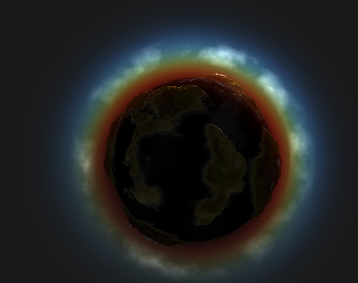
Lighting
Similar to atmosphere lighting
Sample points within the cloud layer, and determine how much light will be transmitted along the view direction
Henyey-Greenstein phase function to mimic how clouds reflect light in real life

Slide 28

Others

Slide 29
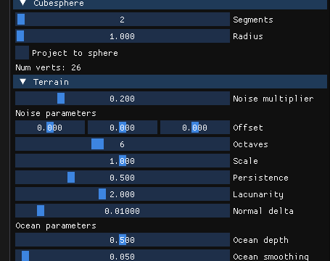
UI
DearImGui
Fast and easy to use
Works with OpenGL and GLFW
Almost every parameter can be customised

Slide 30

Camera
Simple flying camera
Able to be repositioned and reangled using KB+M

Slide 31

Final Renders

Slide 32
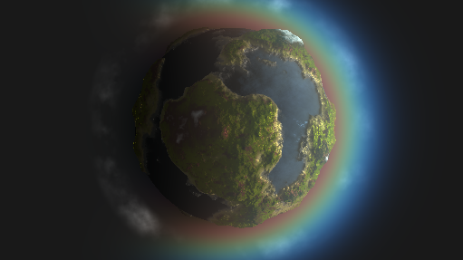
Space view

Slide 33
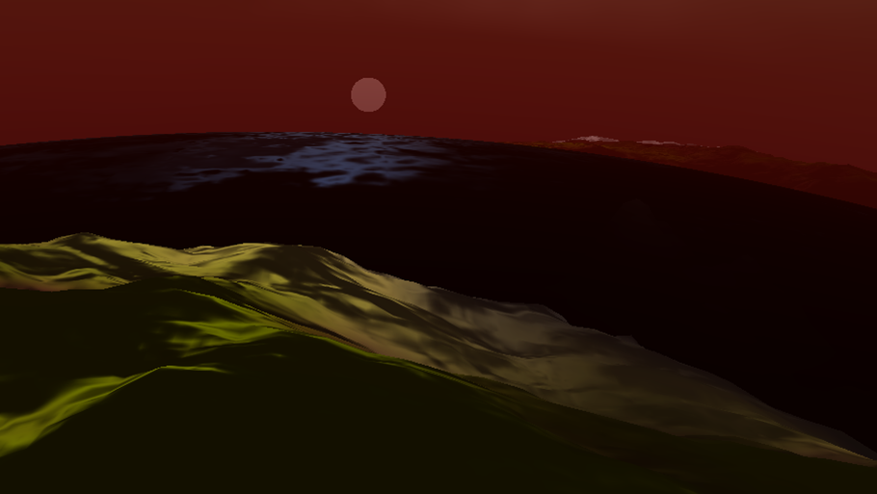
Sunrise

Slide 34
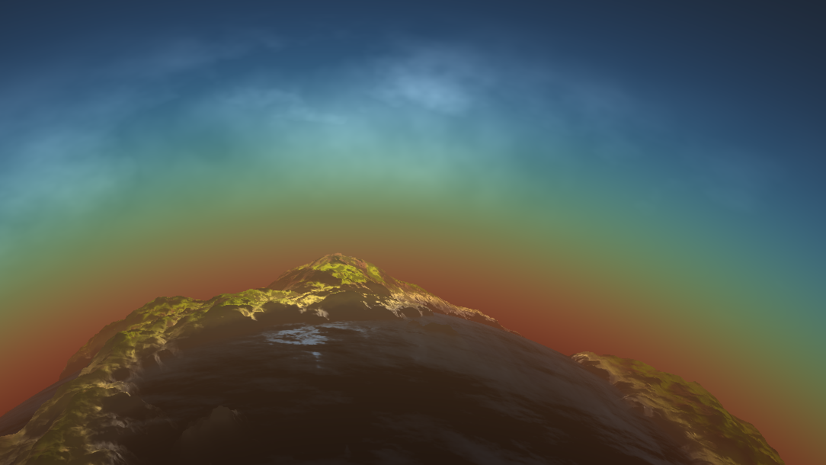
Blue skies

Slide 35
Discussion
Height calculation in vertex shader
No collision data
Postprocessing effects for the ocean
Hard to obtain physical heights
Resort to using normal maps to simulate motion
Performance
One-time calculation of vertex data
Everything else is done on the GPU (Shader magic)
Can be further optimised by precomputing certain data

Slide 36
Resources
Sebastian Lague – Solar System Project
https://www.youtube.com/playlist?list=PLFt_AvWsXl0cSy8fQu3cFycsOzNjF31M1
SimonDev - 3D World Generation
https://www.youtube.com/playlist?list=PLRL3Z3lpLmH3PNGZuDNf2WXnLTHpN9hXy
ShaderToy – Tiny Planet
https://www.shadertoy.com/view/lt3XDM
Real Time Rendering of Procedurally Generated Planets
https://cescg.org/cescg_submission/real-time-rendering-of-procedurally-generated-planets/
FMX2017 Technical Directing Special: Real-time Volumetric Cloud Rendering
https://www.youtube.com/watch?v=8OrvIQUFptA
The Real-time Volumetric Cloudscapes of Horizon: Zero Dawn
http://advances.realtimerendering.com/s2015/The%20Real-time%20Volumetric%20Cloudscapes%20of%20Horizon%20-%20Zero%20Dawn%20-%20ARTR.pdf
ThinMatrix - OpenGL Water Tutorials
https://www.youtube.com/playlist?list=PLRIWtICgwaX23jiqVByUs0bqhnalNTNZh

Slide 37

Demo

